Slide 1
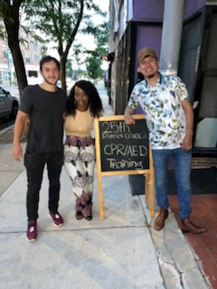


District 025
Building Community
Engaging with Our Residents
PRESENTED BY

Slide 2
Welcome to District 025: Together We Thrive
STRENGTHENING CONNECTIONS FOR A BRIGHTER FUTURE
At District 25, we are dedicated to enhancing our community through collaboration and engagement, ensuring that every voice is heard and every need is addressed effectively.

Slide 3
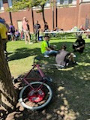
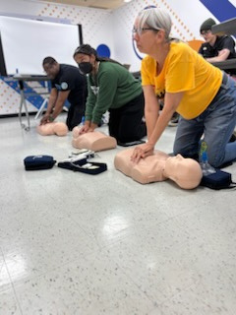
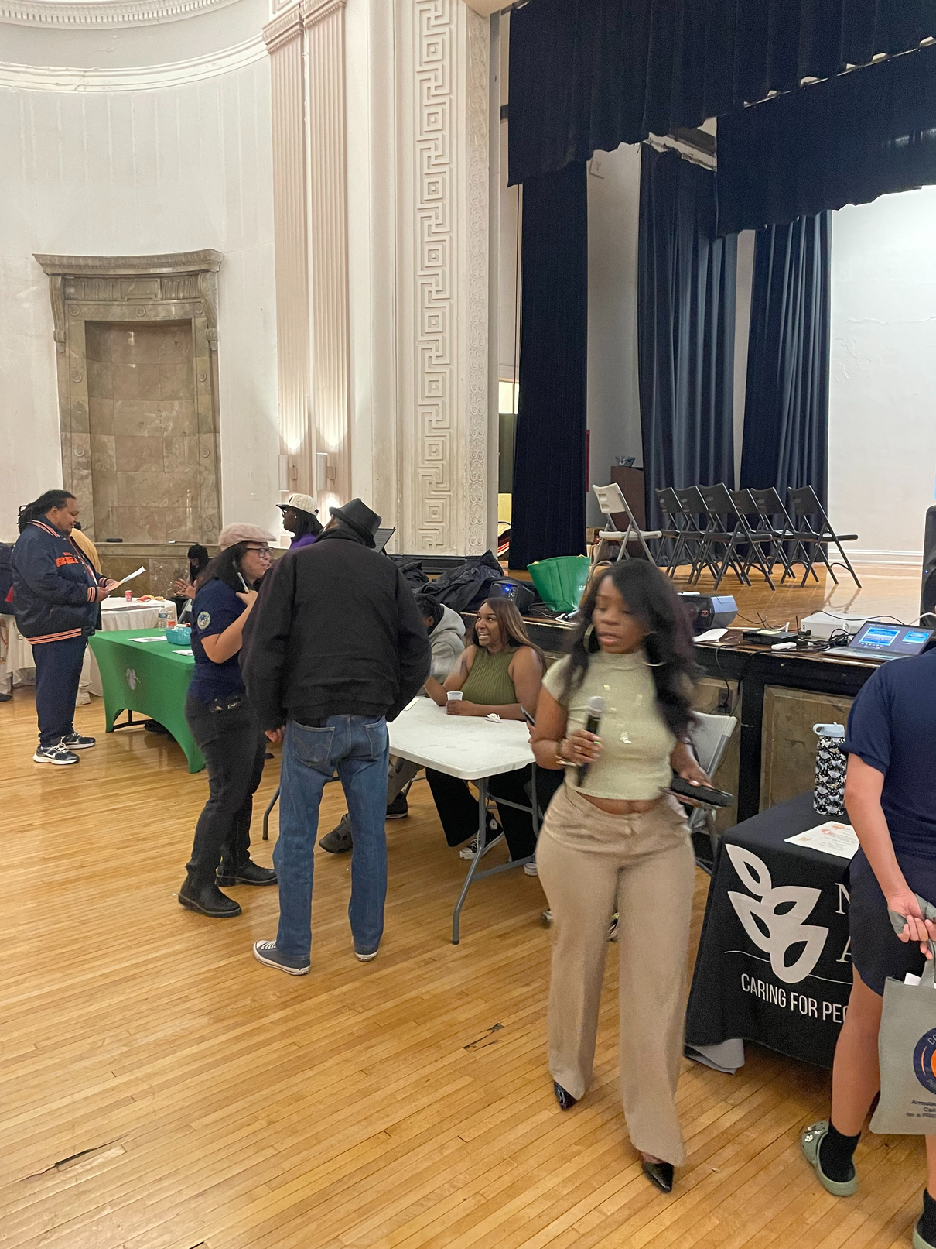
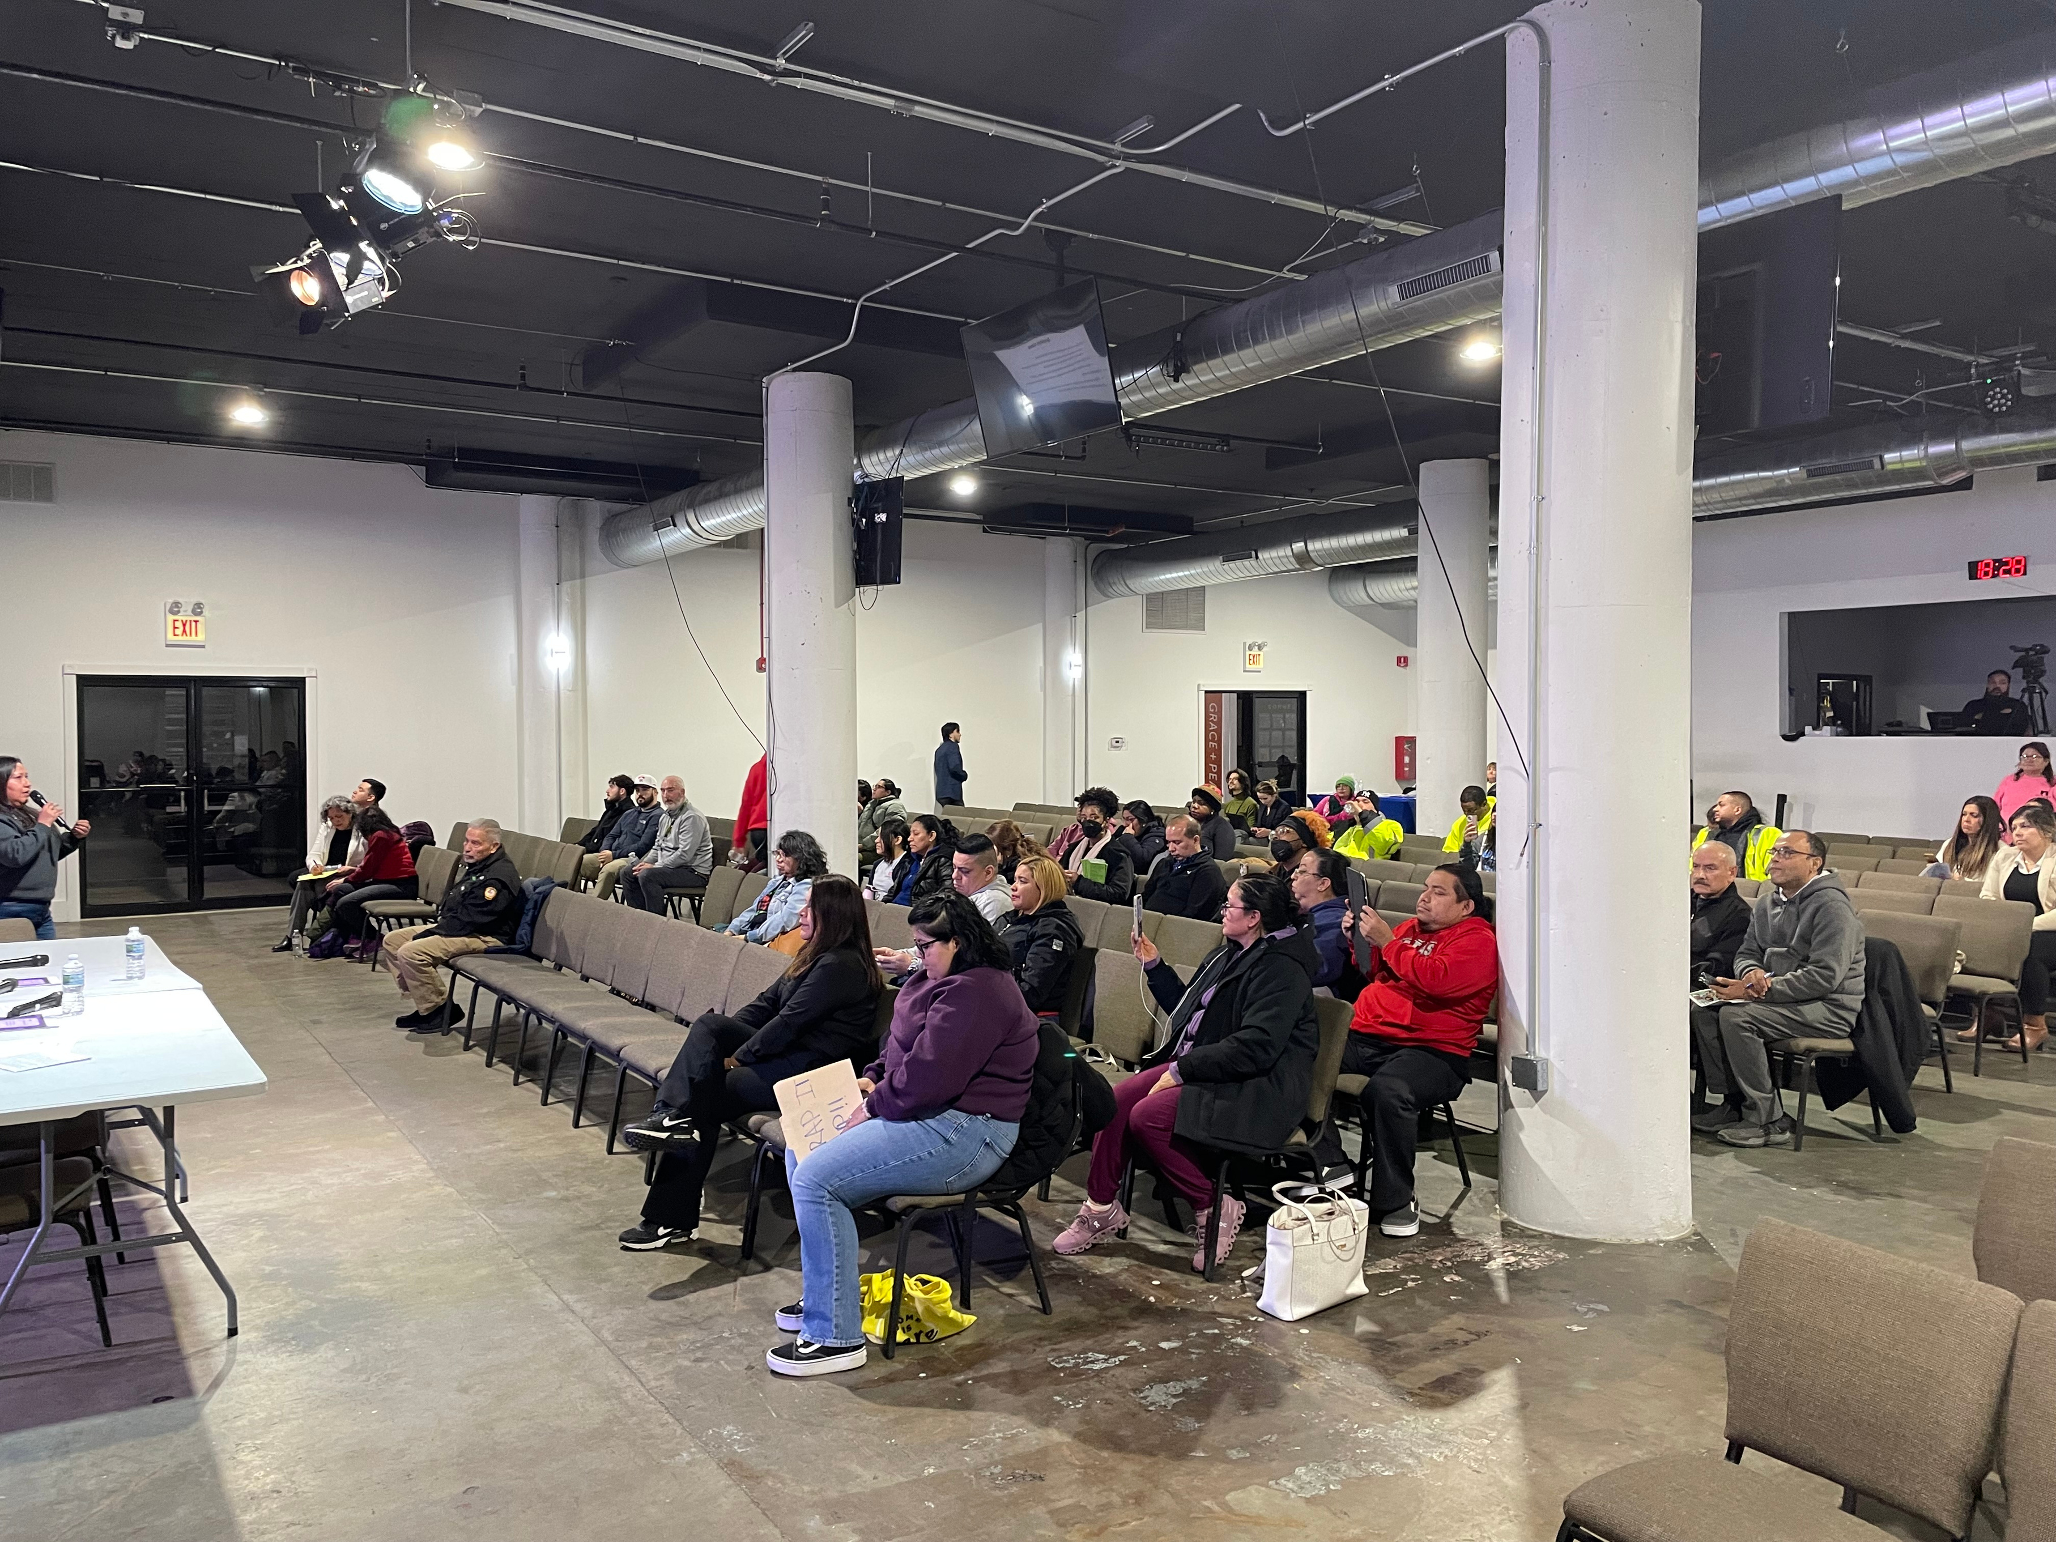
Reviewing 2023-Present
30 Public Meetings Hosted: Providing a consistent monthly forum for community voices.
Over 100 Residents: Gathered for our recent ( November) Black and Brown Unity resource fair.
25 Residents: Newly certified in CPR, ready to save lives in our neighborhood.
3 Connecting Neighborhoods Bike Rides: Bringing joy and health to our streets.
350+ Engaged Residents: A growing digital network receiving regular updates and resources via our email list.

Slide 4
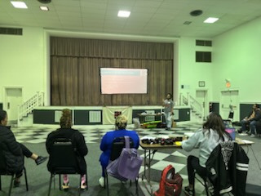
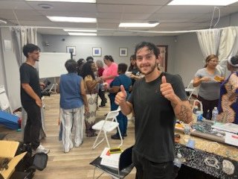
Hands on Training
Mass Community CPR: Over 150 residents participated across 4 sessions.
Professional Certification: Successfully certified 25 residents in life-saving techniques.
Trauma & Prevention:
2 "Stop the Bleed" workshops.
1 Narcan training for overdose prevention.
1 Gun safety and responsible storage session.
Blood Donations: Partnered to host drives specifically for Sickle Cell patients, addressing a critical health need in our community.

Slide 5
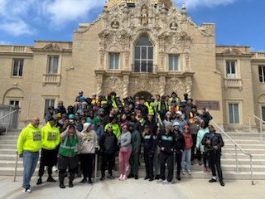
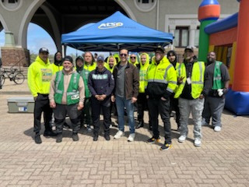
Safety Collaboration
Law Enforcement & Logistics:
Dialogue with the 25th District Police Commander regarding local safety.
Inside look at 911 Dispatch & Emergency Operations with the Office of Emergency Management and Communications (OEMC).
Violence Prevention Partners: Presentations from ALSO, BUILD, and the Institute for Nonviolence on local street outreach and youth programs.

Slide 6
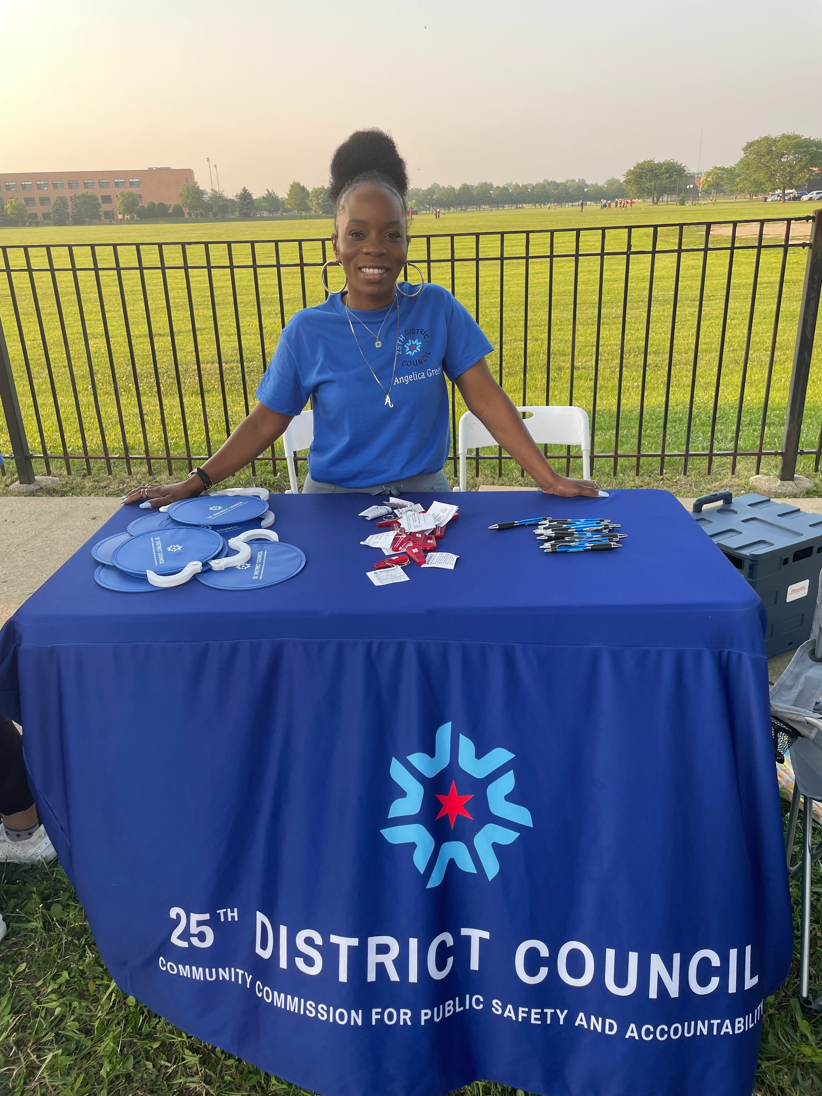
Advocacy & Systemic Impact
Legislative & Policy Action
Mental Health Accountability: Councilor Green co-authored a measure for the CCPSA to mandate that CPD officers consult with mental health professionals, ensuring they are fit for duty and supported in their own wellness.
Treatment Not Trauma: Actively promoting the ordinance to reopen essential City mental health clinics and provide non-police responses to crises.

Slide 7
Advocacy & Systemic Impact
Justice & Civil Rights
Know Your Rights (Immigration): Hosted 2 workshops specifically regarding ICE enforcement. In response to increased federal activity, we equipped residents with the legal tools to protect themselves and their neighbors from rights violations.
The Gang Database: Highlighting how inaccurate listings create systemic barriers to employment and housing.
The Illinois Prison Project: Showcasing successful re-entry strategies for neighbors reintegrating after incarceration.

Slide 8
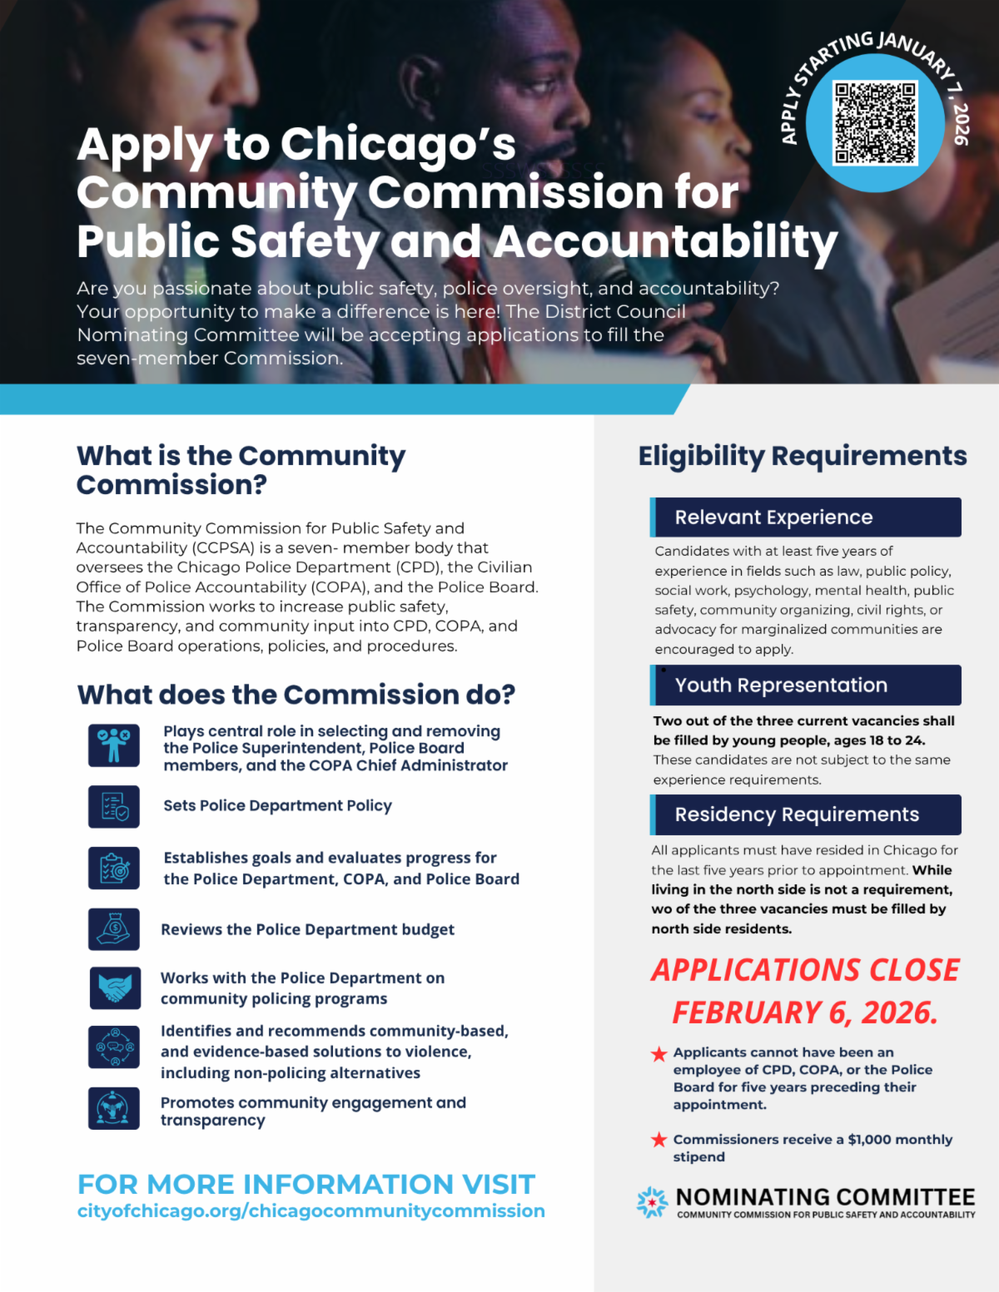
Nominating Committee
This slide highlights an important opportunity for community members to directly shape public safety in Chicago by serving on the Community Commission for Public Safety and Accountability, also known as the CCPSA.
The Commission is a seven-member civilian body that oversees the Chicago Police Department, COPA, and the Police Board. Its role is critical—it helps set police policy, evaluates progress, reviews budgets, and plays a central role in selecting and removing key leadership, including the Police Superintendent.
This is real, structural accountability. Commissioners influence how public safety is defined, how community voices are incorporated, and how transparency is maintained across the system.
Right now, there are open seats, with a strong emphasis on youth representation. Two of the current vacancies are reserved for young people between the ages of 18 and 24, and applicants do not need the same level of professional experience as other candidates. This is a powerful opportunity for young leaders to be at the decision-making table.
Applicants must have lived in Chicago for at least five years, cannot have recently worked for CPD, COPA, or the Police Board, and commissioners receive a monthly stipend.
Applications close on February 6, 2026. If you care about public safety, police accountability, and community-driven solutions, I strongly encourage you—or someone you know—to apply.”

Slide 9
Our Vision for Next Year:
Conclusion: Our Vision for Next Year
Continued Presence: Monthly meetings will remain the heartbeat of our council.
Expanded Reach: Growing our training programs and policy advocacy.
Unity: Keeping our neighborhoods connected through rides, marches, and shared resources.

Slide 10
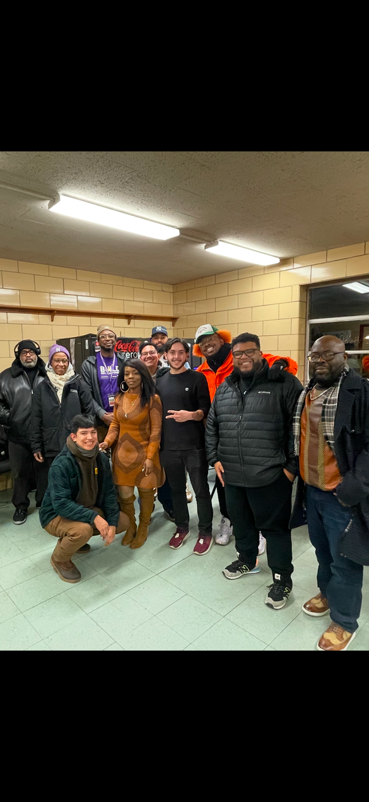
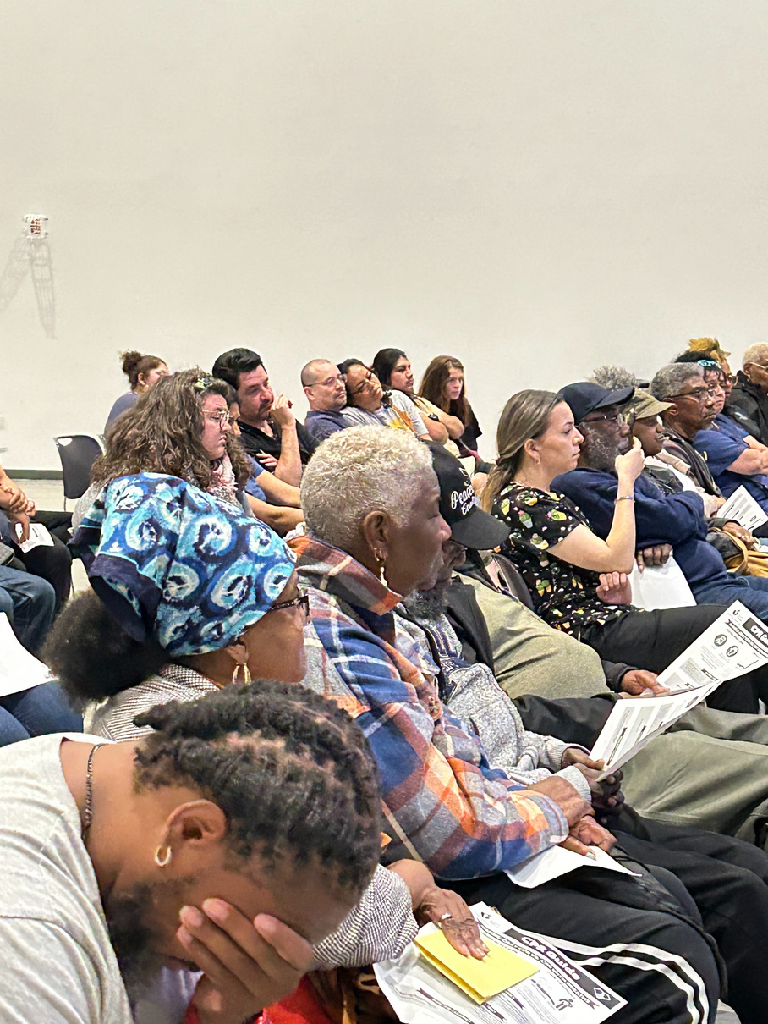
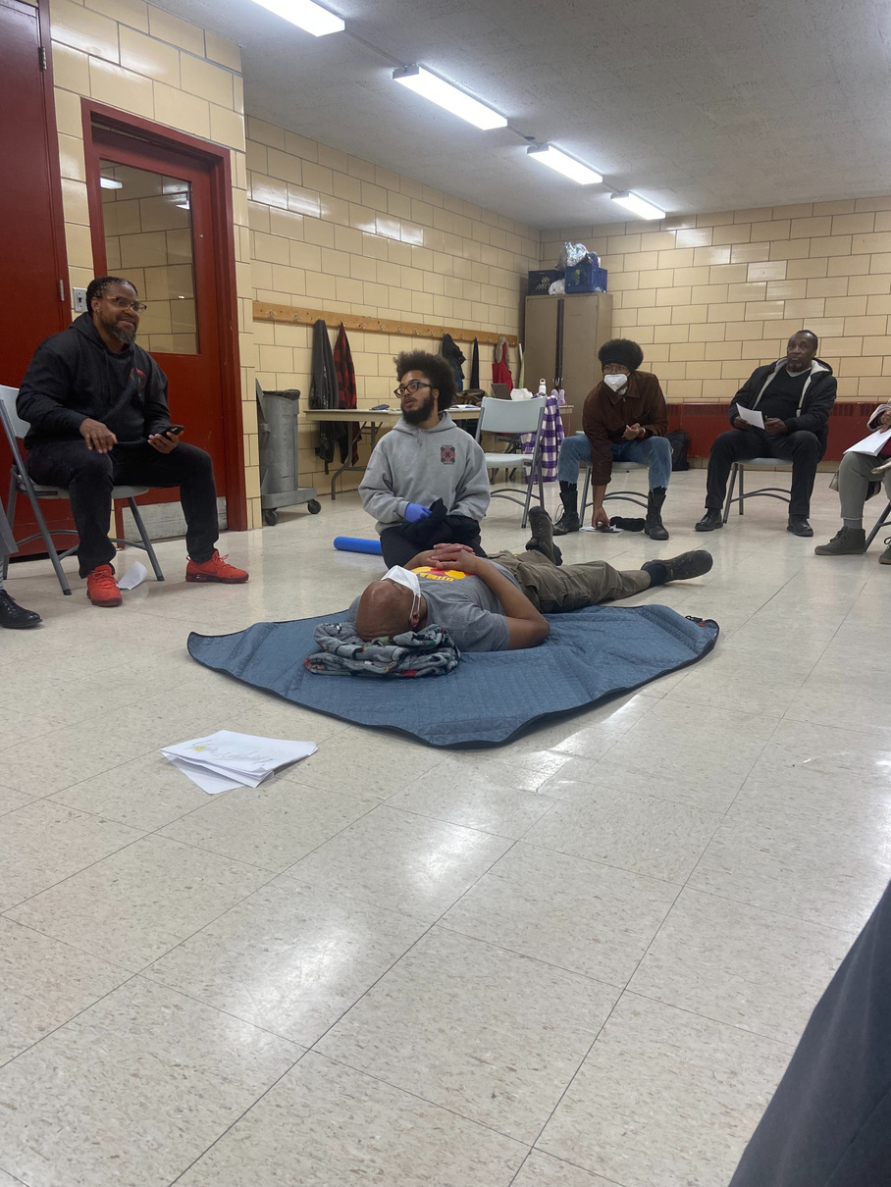
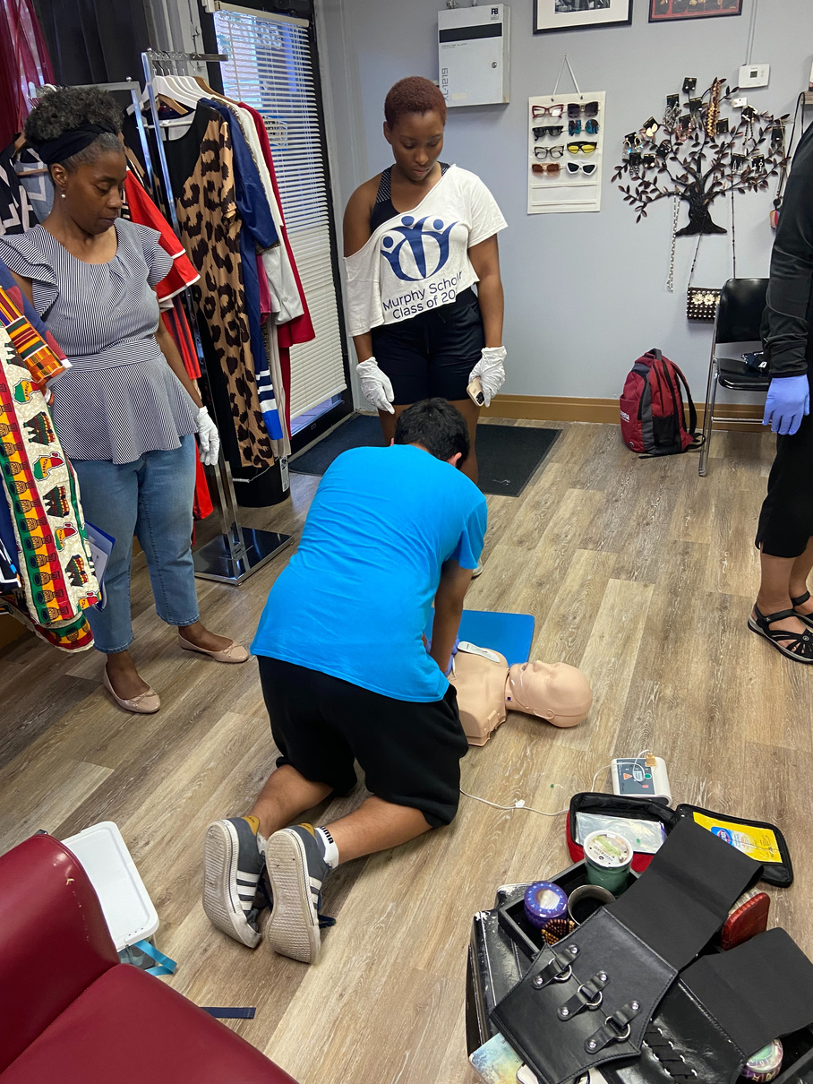
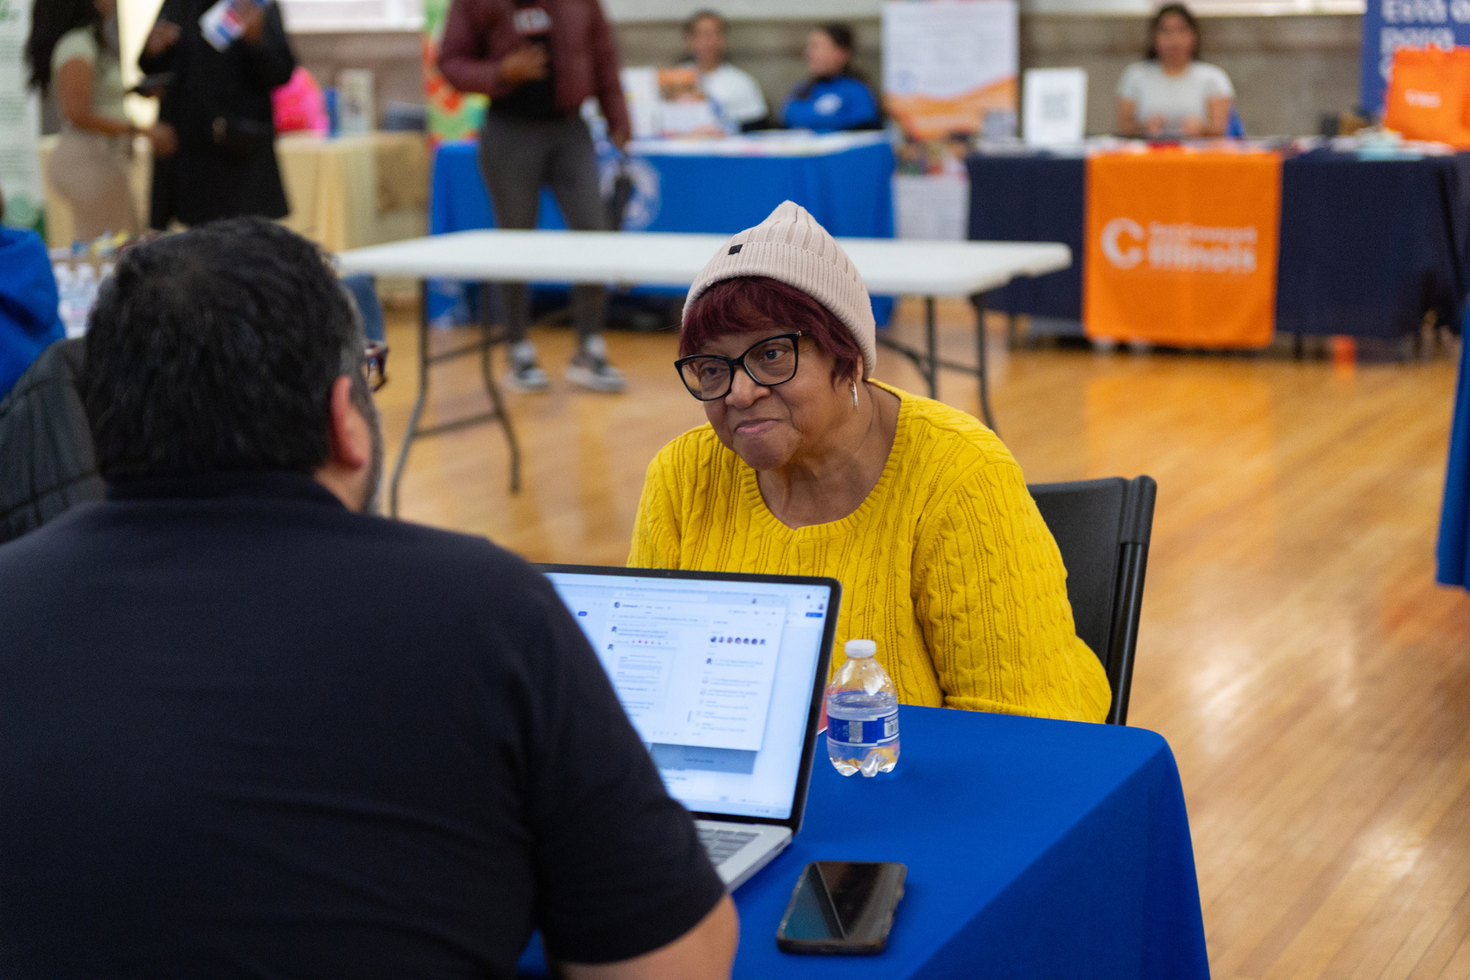
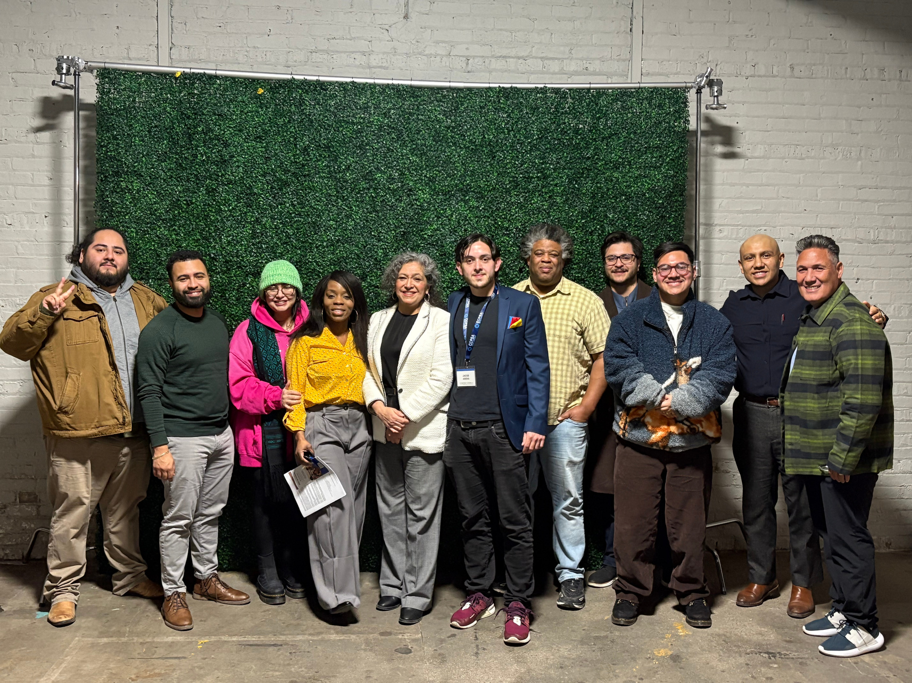
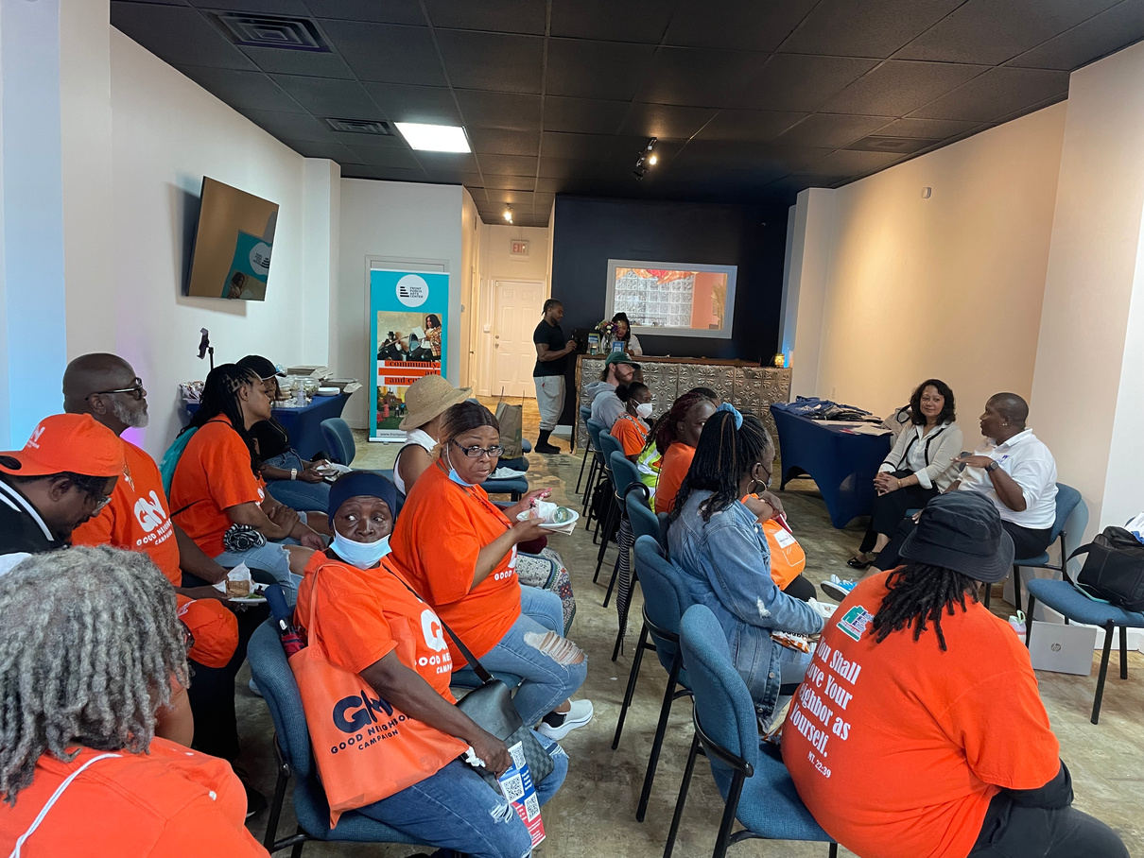
Know Your Rights
Immigration
Gun Safety
Cannibas
CPR Training
Stop the bleed.,
and many more

Slide 11
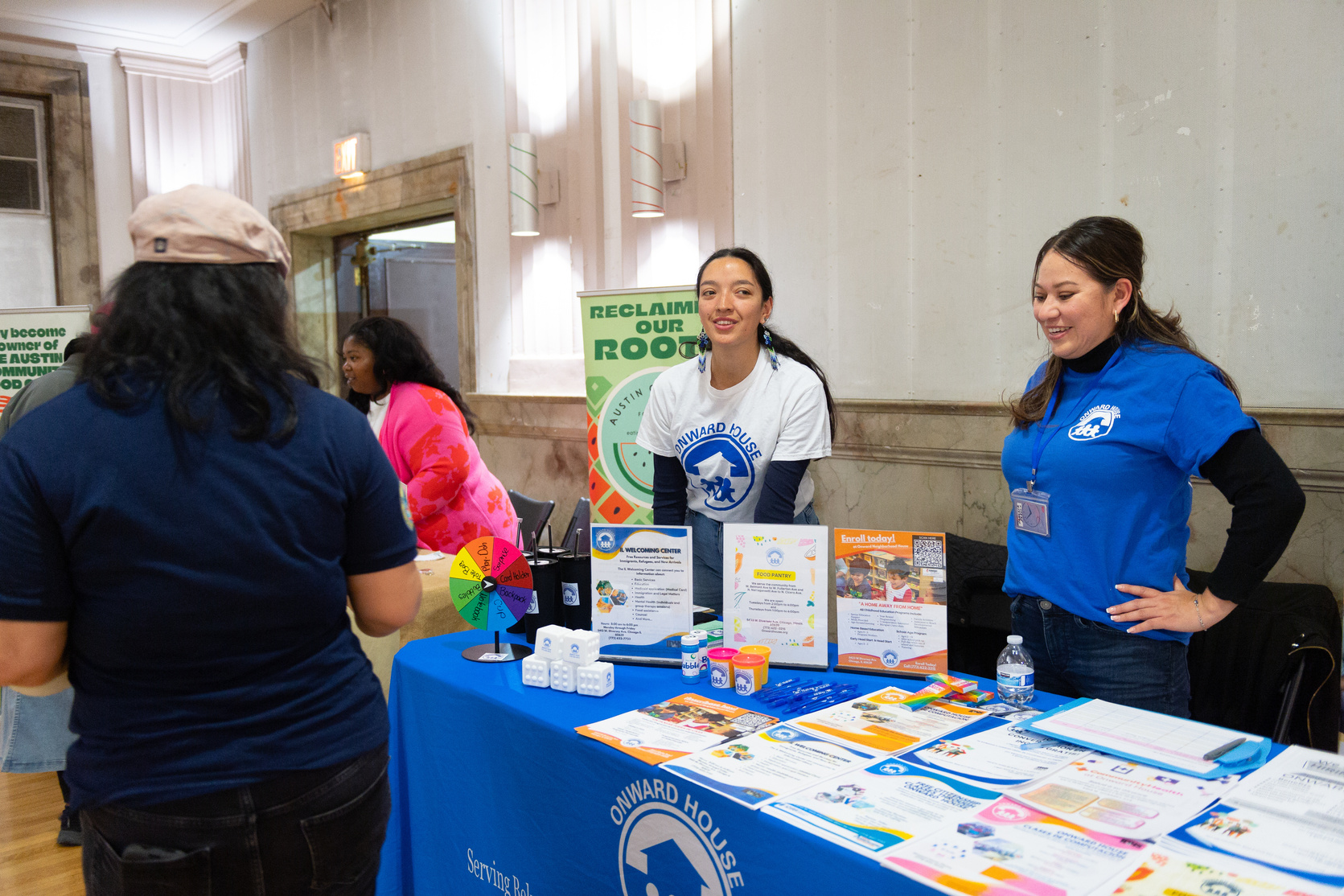
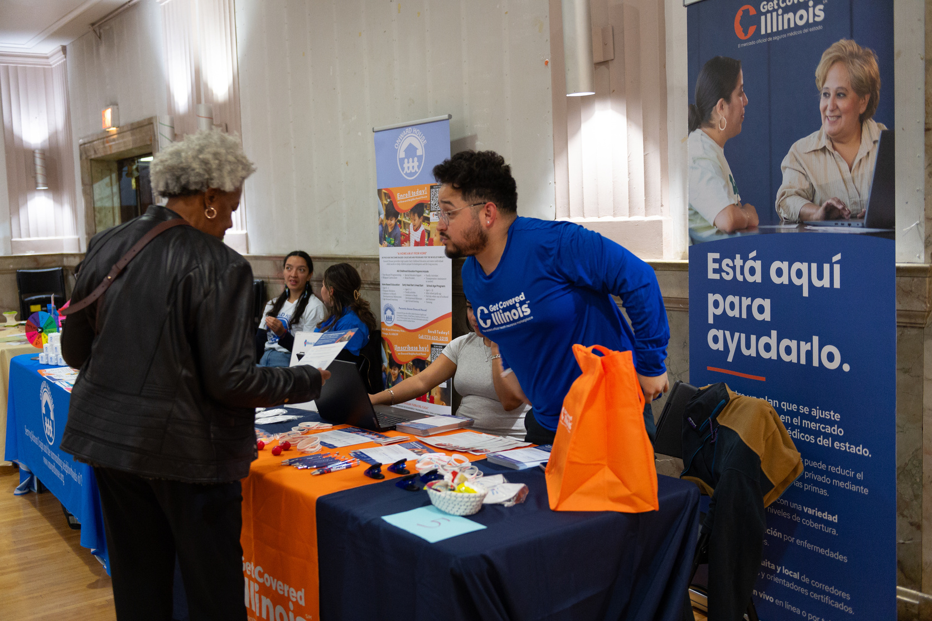
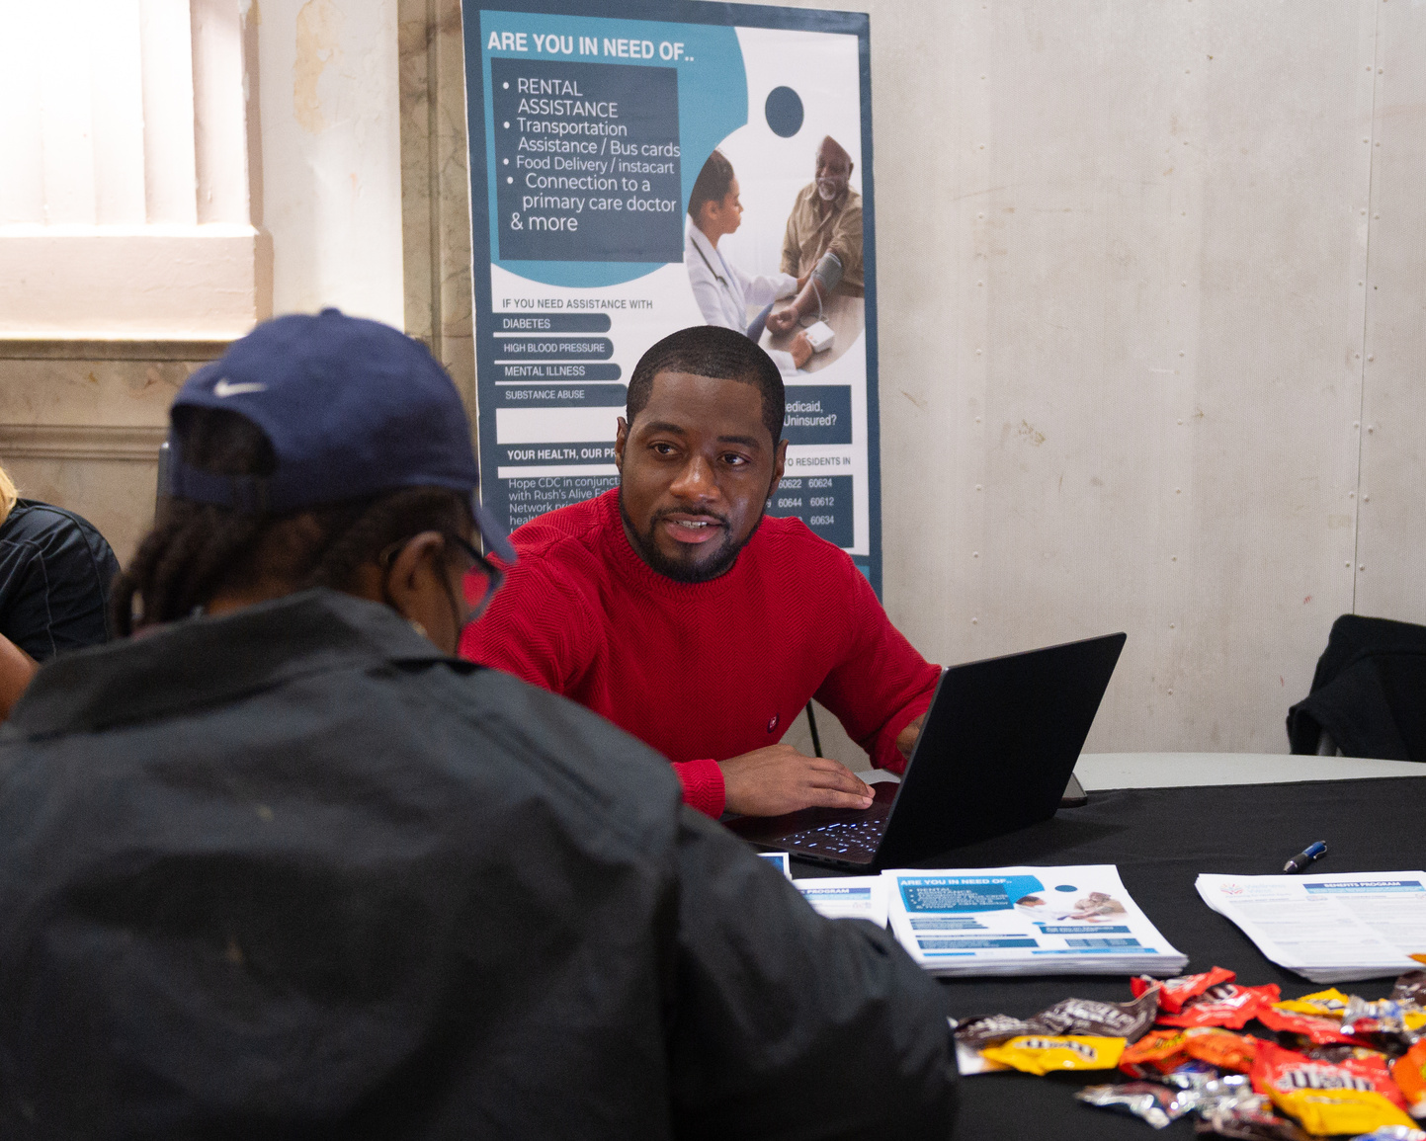
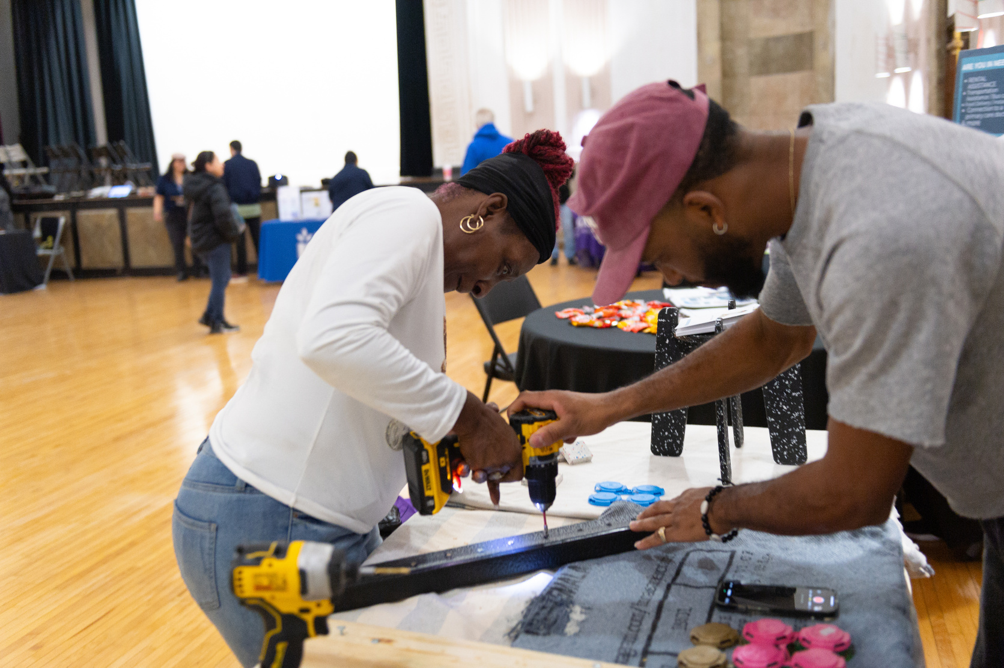
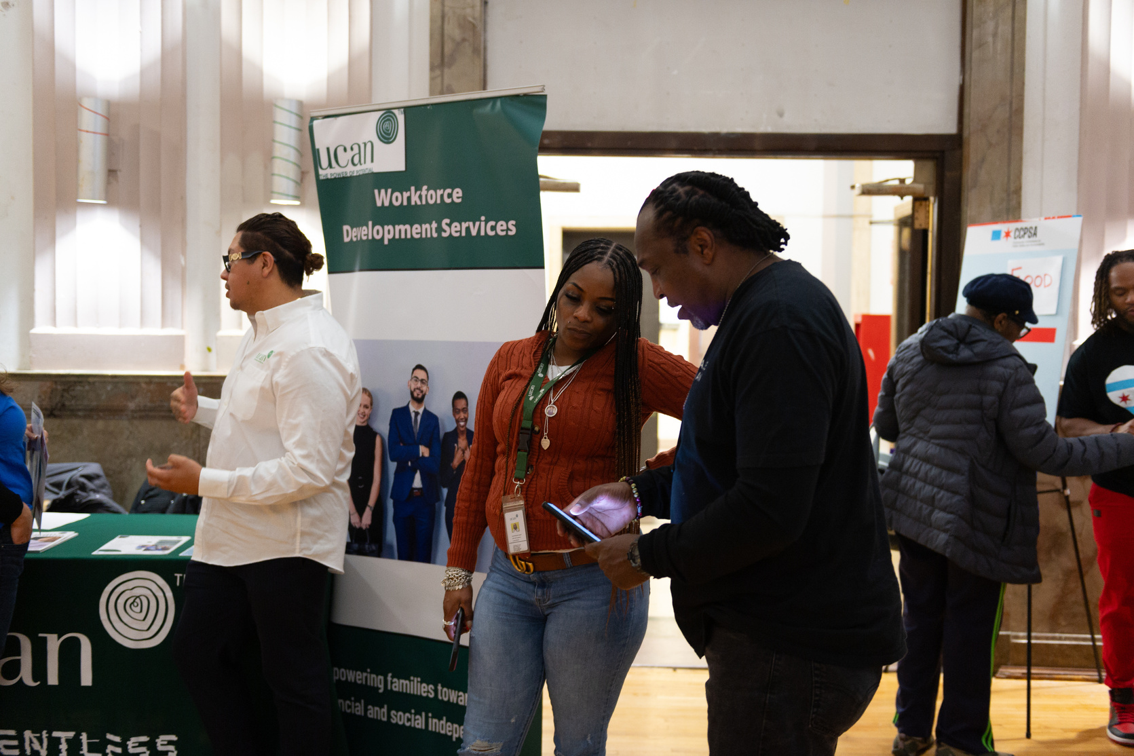
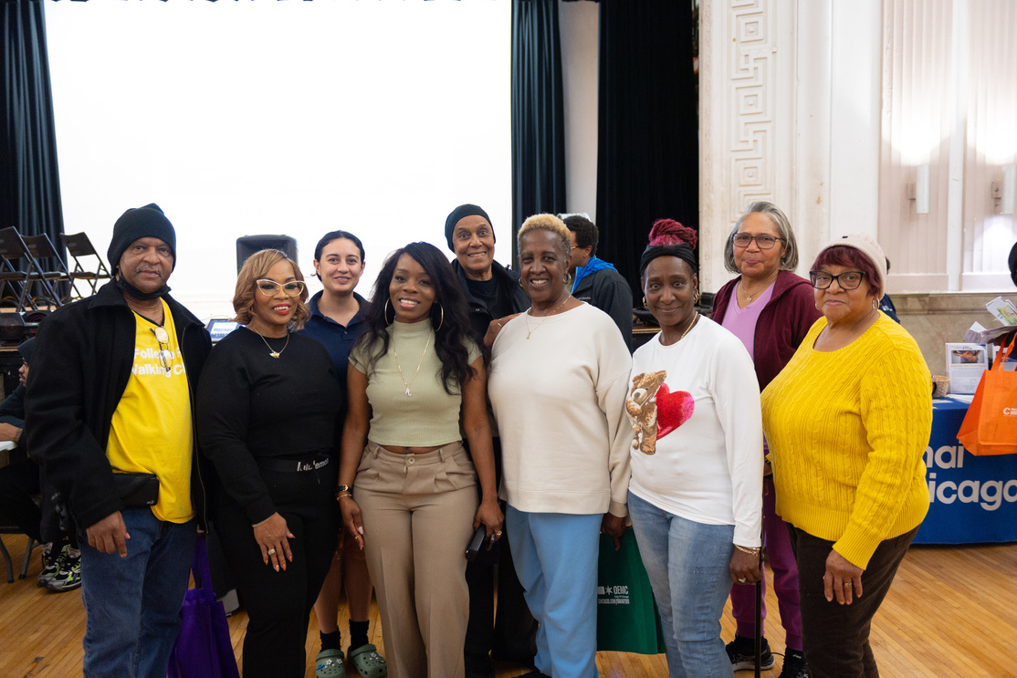
Black and
Brown
Unity Resource Fair
Partnerships

Slide 12
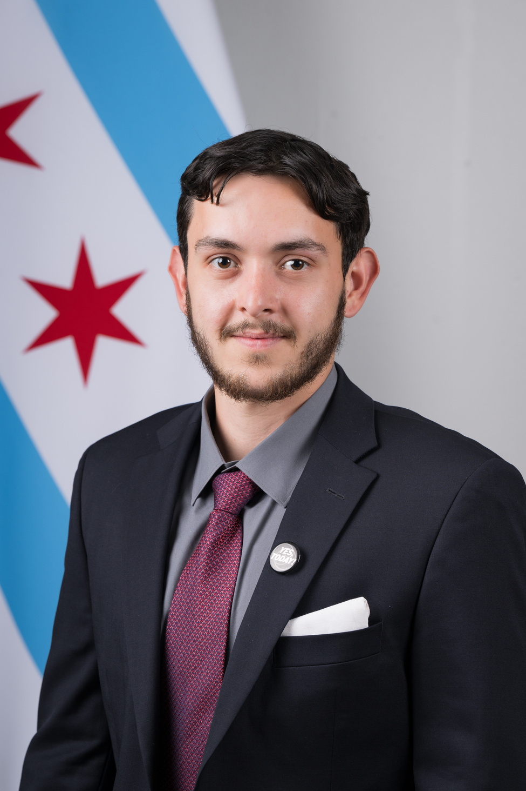
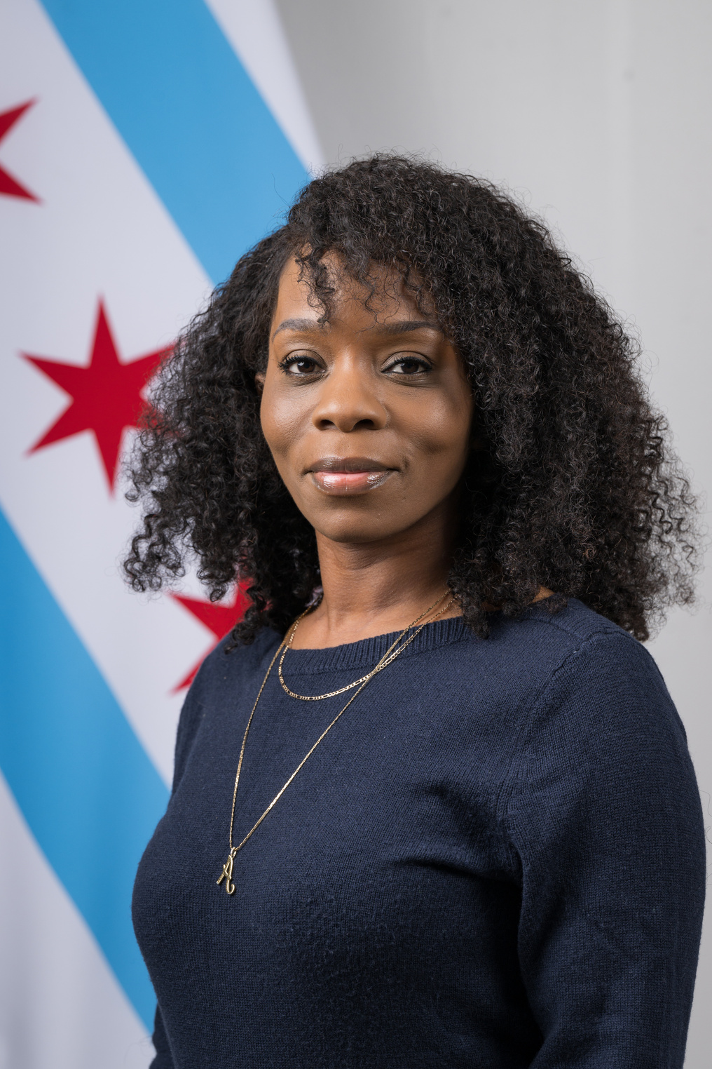
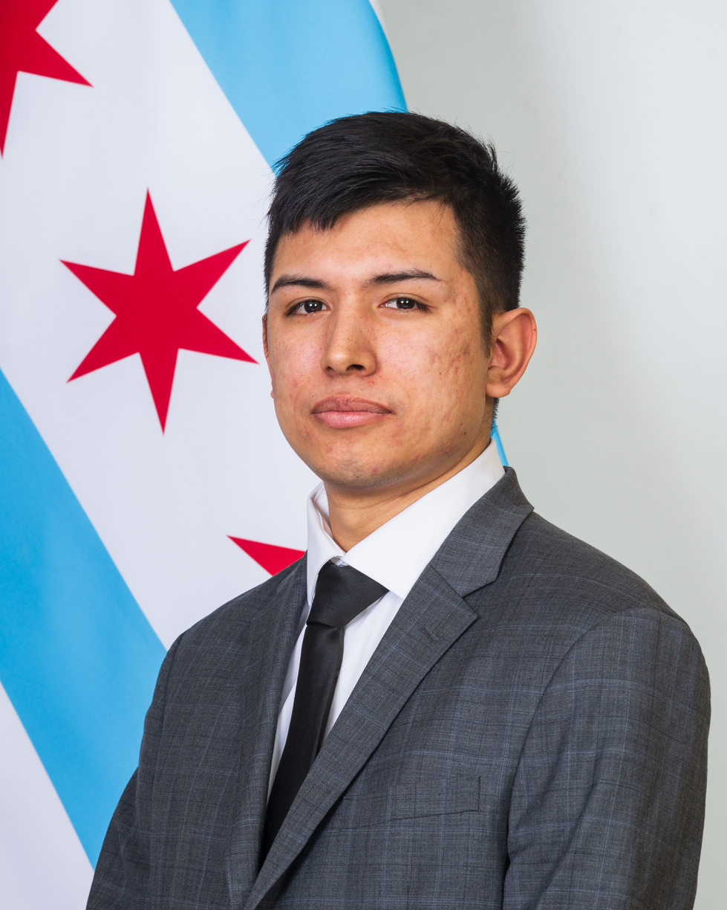
Contact Us
JACOB ARENA
ANGELICA GREEN
SAUL ARELLANO
Chair
Nominating Committee
Community Engagement
Jacob.Arena@cityofchicago.org
Angelic.Green@cityofchicago.org
Saul.Arellano@cityofchicago.org

