Slide 1

Immigration & Know Your Rights
By: Diana Perez: Community
Engagement Director
Pooja Ravindran, Chief of Staff

Slide 2

AGENDA
CIRR Overview
CIRR Current Legislative Work
Federal Immigration Changes
Know Your Rights
CDP & Federal Agent Laws & Restrictions
Community Q&A

Slide 3
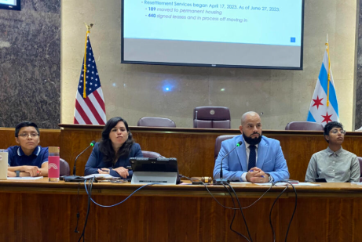
About the Committee on Immigrant and Refugee Rights (CIRR)
For the 2023-2027 term, Alderperson Andre Vasquez (40th Ward) was appointed Chair of the Committee on Immigrant and Refugee Rights (CIRR).
There are 13 other Alders who sit on CIRR. Any legislation that CIRR passes must have at least 8 votes. Then 26 votes are needed to pass full council!
Legislative oversight, community engagement, operations auditing
Call To Action
3 staffers- budget was slashed by 10% by Mayor’s Office

Slide 4
Current CIRR Legislative Work
Ald. Vasquez and Ald. Mike Rodriguez (22nd Ward) introduced a resolution (R2025-0018798) calling on the State of Illinois to prohibit federal agents from concealing their identity and requiring them to present identification and agency-identifying insignia.
On June 4th 2025, many immigrants who were participating in the Alternatives to Detention (ATD) program received surprise texts for check-ins at the ISAP BI Building on S. Michigan Ave. When City staffers and Alders arrived on the scene to join organizers supporting these constituents being surprise detained and torn from their family members by the Department of Homeland Security (DHS), CPD was present and seemed to have a high level of interaction with DHS. This raised red flags around potential violations of Chicago’s Welcoming City Ordinance. Ald. Vasquez has therefore introduced an order (Or2025-0017810) to understand more about the City’s dispatch of CPD to this incident to make sure that Public Safety Departments are well-trained in ordinance compliance. The information released is here.
Ald. Vasquez was notified of a DHS FOIA request to the City that was responded to by a CPD FOIA officer that included arrest records of immigrants with names, places of birth, pictures, and home addresses. In response to this, Ald. Vasquez introduced an ordinance (O2025-0018168) for the Executive Director of the Office of Public Safety and Administration to provide monthly reports to the Chair of the Committee on Immigrant and Refugee Rights to understand FOIA patterns of inquiry by the federal government and to make sure the appropriate redactions to protect personally identifiable information in accordance with FOIA law are being followed in responses. This was referred to the Committee on Public Safety.
Following the above-mentioned disclosure of sensitive data, Ald. Vasquez introduced a resolution (R2025-0018172) calling on all City departments and offices that respond to Freedom of Information Act requests to discuss internal training, response policies and public maintenance of FOIA records to make sure the Bodily Autonomy and Welcoming City Ordinances are not undermined. This was referred to the Committee on Ethics and Government Oversight and we hope to work with Chair Martin to hear this item.

Slide 5
Key Immigration Agencies
Here are the key immigration agencies and their roles:
USCIS (United States Citizenship and Immigration Services): This U.S. federal agency is responsible for processing immigration applications.
ICE (Immigration and Customs Enforcement): This U.S. federal agency is responsible for enforcing immigration laws, including detention and deportation.
CBP (Customs and Border Protection): This U.S. agency enforces customs, immigration, and agricultural laws and regulations at U.S. ports of entry.
EOIR (Executive Office of Immigration Review): This refers to the immigration court where individuals can present their case before a judge and government attorneys. The judge determines the cases and can order deportation.

Slide 6
How is This Federal Administration Changing Immigration Norms?
Jan. 20, Executive Order: empowers the Secretary of Homeland Security (Kristi Noem) to change policies, direct agencies, and set priorities.
Jan 22, Officially deputizes other federal agencies, such as:
ATF - Alcohol, Tobacco, and Firearms DEA - Drug Enforcement Agency FBI - Federal Bureau of Investigations US Marshals ERO - Enforcement Removal Operations DHS - Department of Homeland Security ICE - Immigration & Customs Enforcement HSI - Homeland Security Investigation to carry out immigration enforcement.
Jan 29, Laken Riley Act: DHS can expedite deportation for people with low level crime charges (not conviction), a violation of the due process rights afforded to them in the U.S. Constitution
Notes:
President Trump Signs the Laken Riley Act into Law | Homeland Security
Secretary Noem Reminds Foreign Nationals to Register or Face Legal Penalties | Homeland Security

Slide 7
“Expedited Removal” Program
With Expedited Removal, an immigration officer can quickly detain and deport any individual without allowing an immigration judge to decide over their case if that person:
Entered the United States without being inspected or paroled
Cannot demonstrate that they have been physically present in the United States for at least two years
They are implementing this program in a across the country.
Notes:
Explainer | Too Fast for Fairness: “Expedited Removal” and the Family Expedited Removal Management Program - National Immigrant Justice Center
Expedited Removal Explainer - American Immigration Council

Slide 8
Registration Requirement
The federal government announced a process by which non citizens must register their presence in the United States went in effect on April 11th.
The goal of the registration process is to use this information to find, arrest, and deport people or pressure them to leave.
Potential immigration and criminal consequences of registering
Some people are considered to have already registered
Legal permanent residents (LPRs), people with parole, people with employment authorizations, people who entered on visas, in removal proceedings, refugees
Criminal consequences of failure to register, failure to carry proof of registration, failure to update address within 10 days of moving
It its important to consult with an immigration attorney or accredited representative
Notes:
NIJC Calls for Halt to Trump’s New Draconian Registration Requirement that Endangers Immigrants’ Fundamental Rights - National Immigrant Justice Center
FAQ: The Trump Immigration Registration Requirement - NILC

Slide 9
Local Policies in Illinois and Chicago
City
Welcoming City Ordinance:
prohibits all city agencies including CPD from:
assisting federal agencies in civil federal immigration enforcement activities
collecting immigration status in the provision of services or benefits
allows comparative-to-state ID documents to be accepted as ID within the City
suggests 311 resource line for immigration resources
creates quarterly reporting requirements for CPD around federal immigration requests
creates HR process for reporting violations of ordinance
creates form for CPD to fill out to certify victim cooperation in reporting a crime
State
Illinois Way Forward Act: Illinois Law Enforcement Agencies are prohibited from asking about your immigration status
Illinois TRUST Act: Illinois Law Enforcement Agencies are prohibited from holding you for additional time after processing at the request of ICE

Slide 10
Immigration Agents at your Home
Stay calm
You are not required to open the door to ICE unless they present a valid arrest warrant signed by a judge.
If agents enter without a permission, say I do not consent this search. Ask for a warrant
Do not answer and question or lie. Exercise the right to remain silent
Do not sign any documents
Ask to speak with an immigration attorney
If they attempt to force the door open, make note of as many details as possible (agent name/ID, vehicle license plate number, etc).

Slide 11
Immigration Agents at Work
Remain silent, if you choose to speak, remember not to lie
Show your valid documentation or a copy of your pending process
Ask for a warrant and check to see if you name is on it and spelled correctly
Do not sign anything
Do not consent to being search and verbally say I do not consent to be search
Don’t carry a passport. A passport is a travel document and if you have it on you while detained, it can help ICE deport you faster.
Don’t provide a foreign ID, this includes your consulate ID, foreign driver’s license. A foreign ID reveals to the ICE agent that you were born in another country that is not the U.S.

Slide 12

Immigrant Agents in Private Space
Private species are areas where individuals have reasonable expectations as private such as homes or other private properties.
Immigration enforcement officers will need a judicial warrant signed by a Judge or the consent of resident to enter.
Examples of private spaces: A person home, areas inside a business that are not open to the public, offices, employees only areas.

Slide 13
Immigrant Agents in Public Spaces
ICE does not need a judicial warrant to look for individuals in a public space. If you are stopped on the street, ask if you are under arrest and if you are free to leave. If the officer indicates you may leave, do so in a calm manner.
Examples public area: street, sidewalks, public parks, open areas of businesses such as restaurant dining areas.
If ICE comes
DO NOT LIE. Say that you want to exercise your right to remain silent. Do not give any explanations, excuses, or make up stories.
Do not claim to be a U.S. citizen if you are not!
Don’t provide a foreign ID, this includes your consulate card, foreign driver’s license. A foreign ID reveals to the ICE agent that you were born in another country that is not the U.S.
DO NOT SIGN any document.

Slide 14
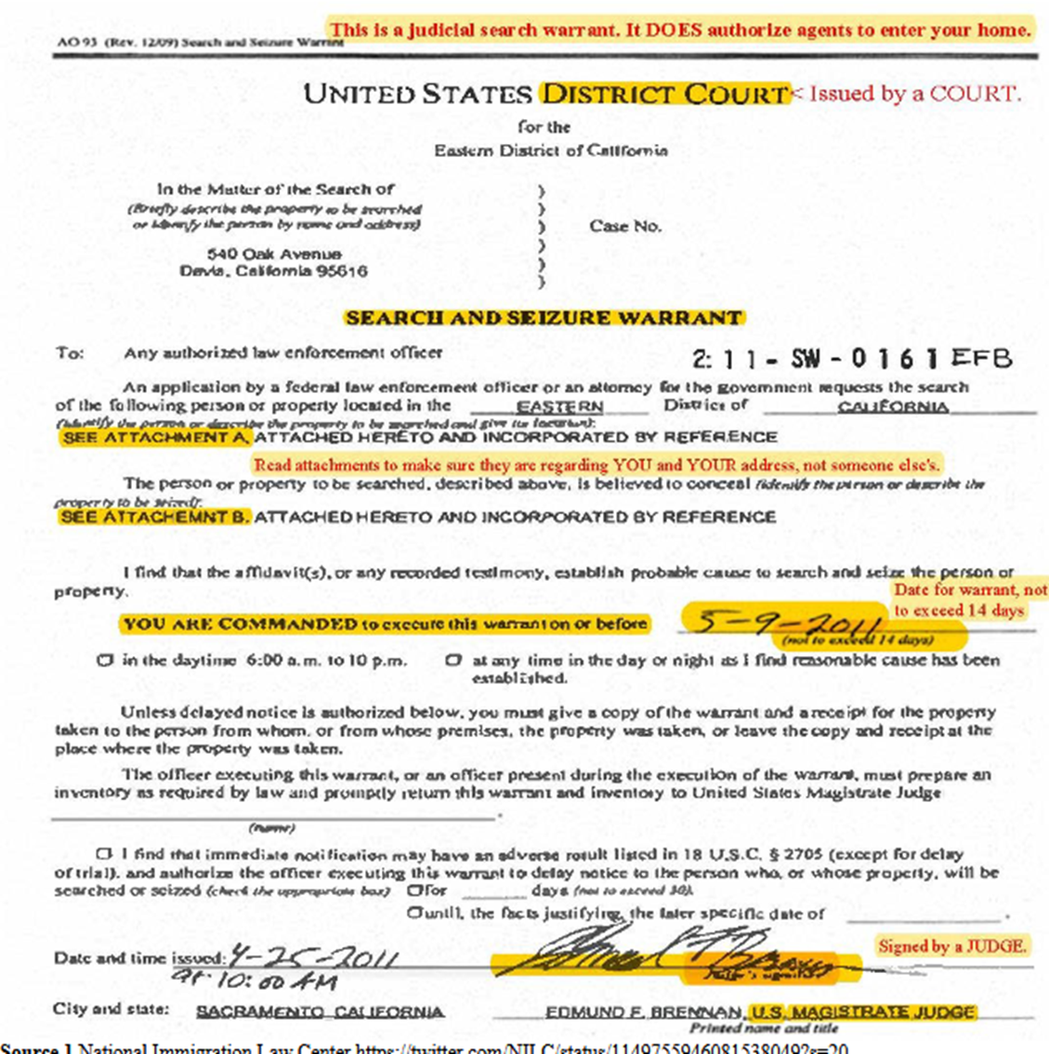
Judicial Warrants
Judicial Warrants –is an official court order signed by a judge or magistrate that authorizes a search of private property, seizure, or arrest based on the cause.
A judicial warrant will:
MUST HAVE CORRECT NAME AND ADDRESS, A VALID DATE
Be issued by a court and signed by a Judge or magistrate.

Slide 15
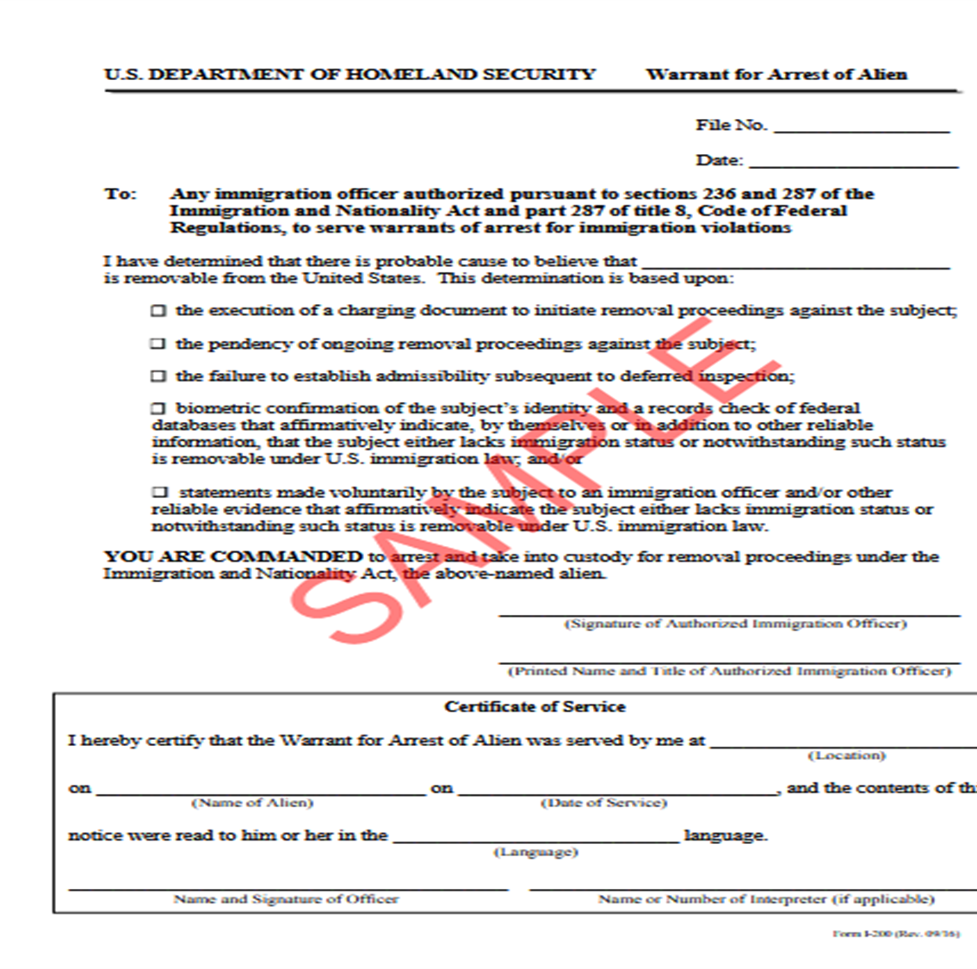
Administrative Warrants
Administrative Warrants – issued by a federal agency such as Department of Homeland Security (DHS) or Immigration and Customs Enforcement (ICE), purporting to document their authority to arrest a person suspected of violating immigration laws.
These administrative documents are not signed by a judge but rather an immigration officer like an ICE agent or immigration judge.
An ICE administrative warrant is NOT a judicial warrant.
ICE administrative warrants do not give ICE officials authority to enter a place where there is a reasonable expectation of privacy, without consent.

Slide 16
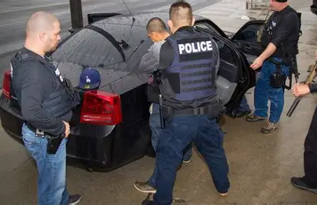
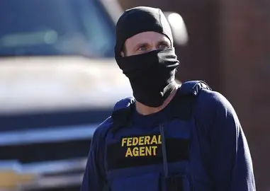
How to identify DHS/ICE Officers
ICE may wear civilian or plain clothing
with black bulletproof vest.
Often the vest says “POLICE” on the front or back.
Wearing mask to cover their faces

Slide 17
How to Identify Chicago Police Officers
Local police wear distinctive uniforms with Identifying insignia.

Slide 18
What to Do If Detained by ICE
Locate them Locator ICE
Call ICIRR Hotline
Reach out Consulates depending where the person national origins
Call an attorney or legal representative
Other things to consider
Emergency plan for your family in the event that one of both of the parents are detained, see these tips from the Resurrection Project.
It important to memorize any important phone numbers
Make copies of anu legal documents such as passport, birth certificates, and important documents. Tell your family where you keep them in case of a situation.
Apply for a passport for your U.S Citizen child so they are able to travel to and from the US.
See CIRR Immigration Enforcement Reporting and Detention Support Guide in Resources slide!

Slide 19
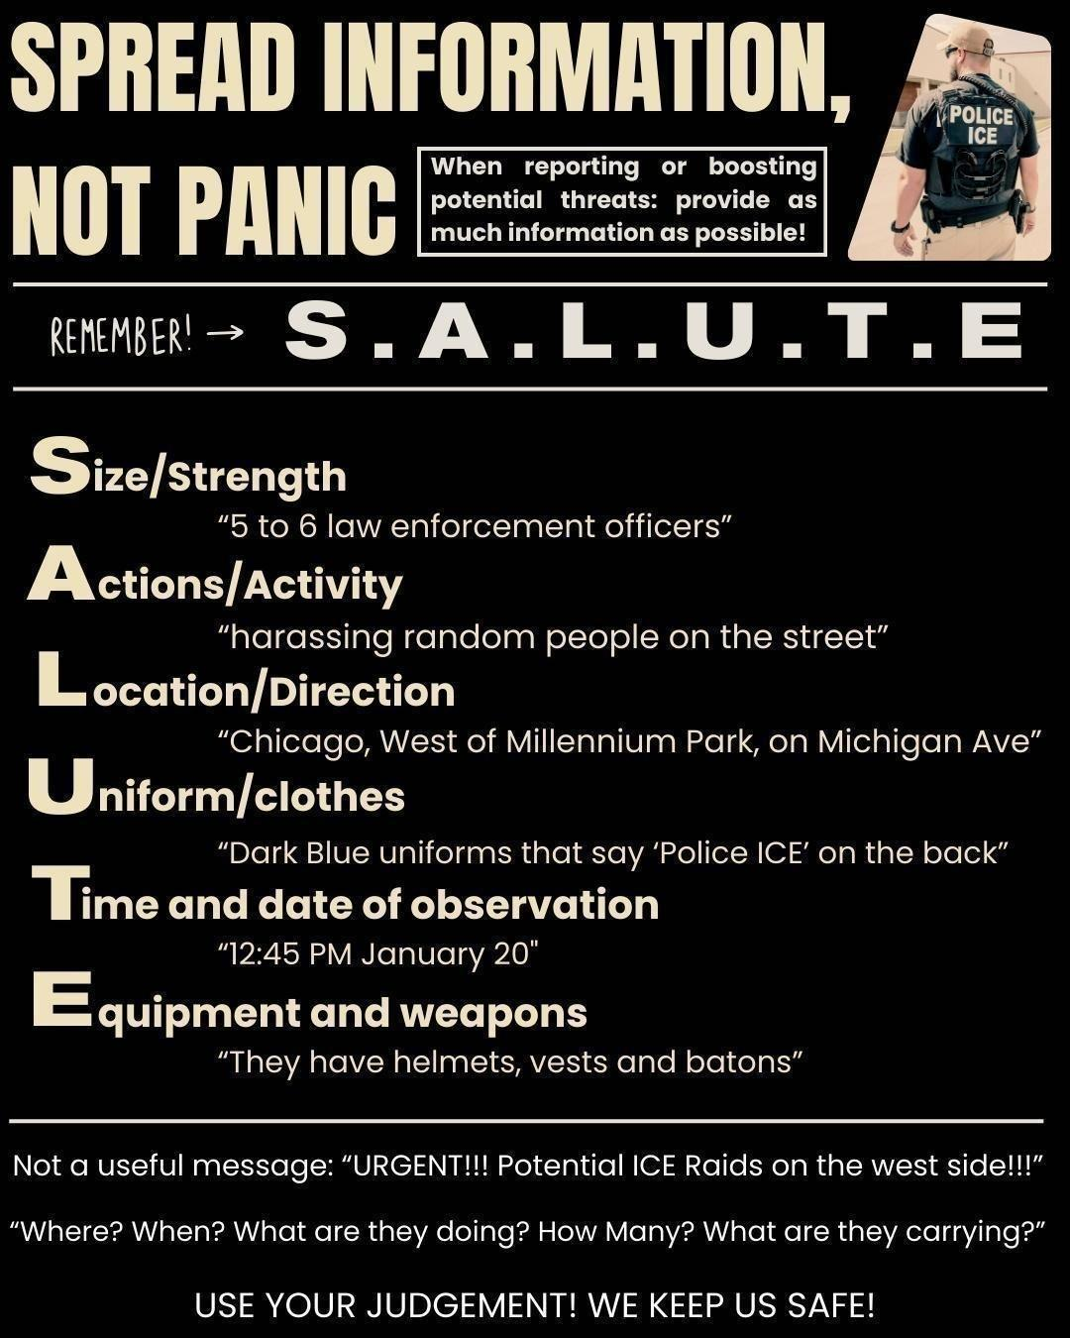
How to Report ICE Activity
Call ICIRR Hotline (1-855-435-7693)
Male sure to report:
Size/strength
Actions/activity
Location/direction
Uniform/clothes
Time/date of observation
Equipment and weapons

Slide 20
How Can You Support Immigrants?
Join a Rapid Response Network in your area
Report ICE sightings or detentions
ICIRR Hotline 1-855-435-7693
www.TRPimmigrantjustice.org/reportice
Donate to organizations like OCAD,
Canvass with CIRR to connect street peddlers with opportunities
Volunteer for Know Your Rights business canvasses with Jewish Council for Urban Affairs and Asian Americans Advancing Justice
Sign up to Court Watch
Volunteer opportunities:
40thward.org/immigrantrights
illinoisimmigrationinfo.org/volunteer

Slide 21
Legal Support & Other Resources
40thward.org/immigrantrights
CIRR Immigration Enforcement Reporting and Detention Support Guide: bit.ly/
NEW! Illinois Immigration Info
illinoisimmigrationinfo.org/
NIJC
KYR: What to do if you or a Loved one is Detained
KYR: ICE at Immigration Court
ICIRR
KYR PDF
ICIRR Family Support Hotline
The Resurrection Project
Know Your Rights
Legal Assistance
Detained Loved one Form
The Immigration Division of the Cook County Public Defender's Office
https://www.cookcountypublicdefender.org/resources/immigration-division
ICE Locator and Detention
Visit the ICE locator online
USCIS informational pages
Visit https://www.uscis.gov/
As of July 1, 2024, undocumented immigrants in Illinois can obtain a standard driver's license, which is not a REAL ID, but can be used for identification and driving within the state, replacing the previous Temporary Visitor Driver's License: http://ilsos.gov/departments/drivers/drivers_license/renewonline.html

Slide 22
Follow the Committee Everywhere!
Website: welcometochicago.org
Sign up for our newsletter!
Instagram: @chicagocirr
Facebook: Chicago Committee on Immigrant and Refugee Rights

